Slide 1
Et in unum diem durantia sceleris vestigia nostri mundi existunt
The ephemeral footprint of our cosmic existence
Johel batista

Slide 2


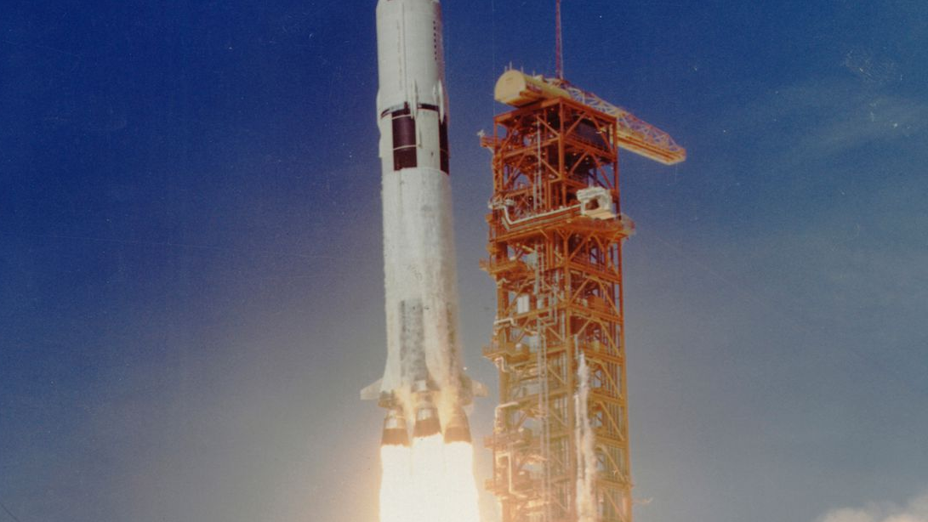
A day like today 07/16/1969

Slide 3
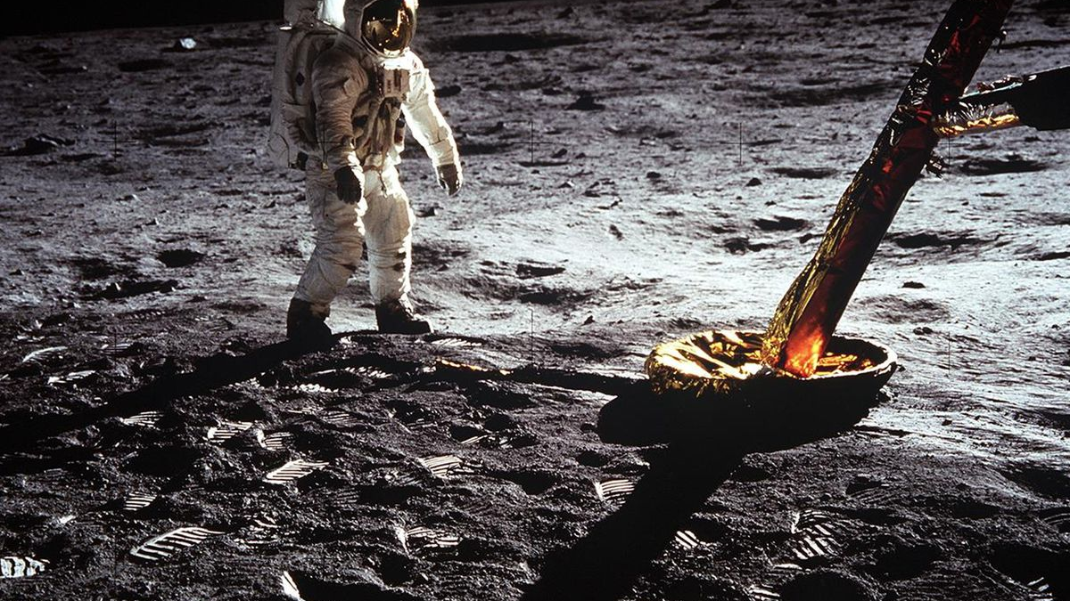
That's one small step for [a] man, one giant leap for mankind – Neil aMSTRONG

Slide 4
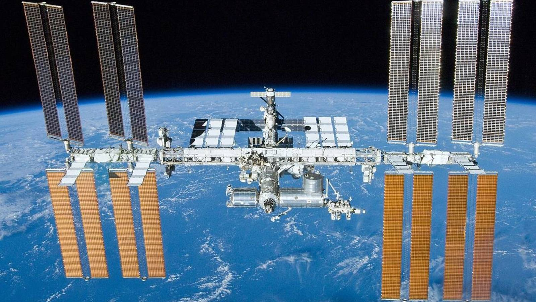
Meanwhile waiting to make the leap to the universe

Slide 5
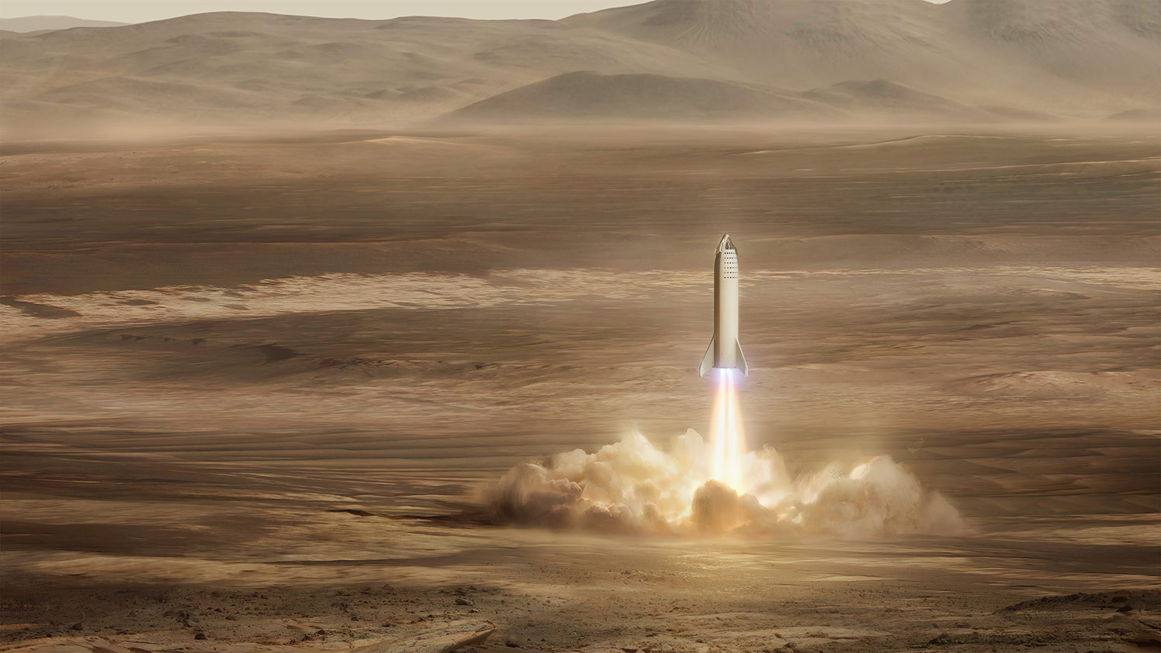
We were born too late to explore the Earth, but maybe at the exact moment to explore other planets

